Slide 1
Breast cancer prediction
Using Support Vector Machines (SVM)

Slide 2
Table of Contents
01
02
03
04
Introduction
Exploratory data analysis
SVM
Results

Slide 3
01
Introduction

Slide 4
Breast cancer statistics - worldwide
By 2020, 7 800 000 women alive were diagnosed with breast cancer in past 5 years
2 300 000 new diagnosed cases in 2020
685 000 resulted in death in 2020
It is the most frequently diagnosed cancer among women in 140 of 184 countries

Slide 5
Target
- Occurs at any age after puberty but with increasing rates in later life.
- Half have no risk factors other than gender (female) and age (over 40 years).
- If all risk factors could be controlled, it would only reduce the risk of developing breast cancer by at most 30%.
Gender
99%
Women
1%
Men
Machine learning
techniques
Mortality in high-income countries dropped by 40% between the 1980s and 2020.(2-4%)
If an annual mortality reduction of 2.5% per year occurs worldwide, 2.5 million breast cancer deaths would be avoided between 2020 and 2040.

Slide 6
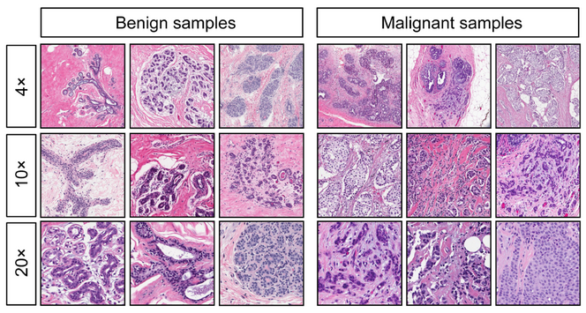
Dataset,0.00
24h 37m 23s
Features are computed from a digitized image of a fine needle aspirate (FNA) of a breast mass. They describe characteristics of the cell nuclei.
is Jupiter’s rotation period

Slide 7
Attribute Information:
ID
Diagnosis (M = malignant, B = benign) → 1,-1
Ten real-valued features are computed for each cell nucleus (3–32):
a) radius (mean of distances from the center to points on the perimeter)
b) texture (standard deviation of gray-scale values)
c) perimeter
d) area
e) smoothness (local variation in radius lengths)
f) compactness (perimeter² / area — 1.0)
g) concavity (severity of concave portions of the contour)
h) concave points (number of concave portions of the contour)
i) symmetry
j) fractal dimension (“coastline approximation” — 1)

Slide 8
02
EDA

Slide 9
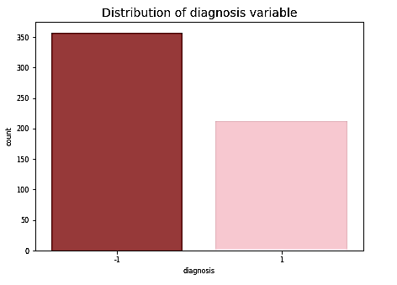
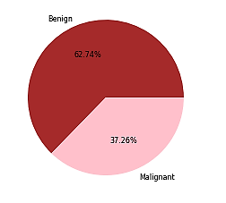
We have 357 malignant cases and 212 benign cases so our dataset is Imbalanced

Slide 10
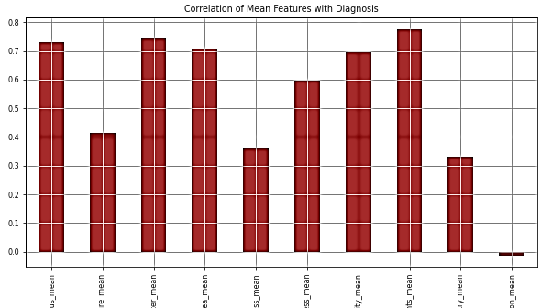
Fractal dimension mean least correlated with the diagnosis variable.
All other mean features have a significant correlation with the diagnosis variable.

Slide 11
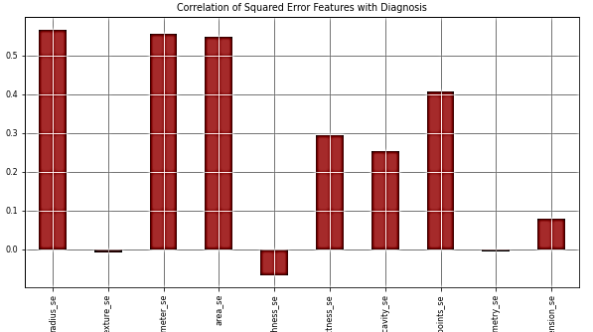
texture se, smoothness se, symmetry se, and fractal dimension se are least correlated with the diagnosis variable.
All other squared error features have a significant correlation with the diagnosis variable.

Slide 12
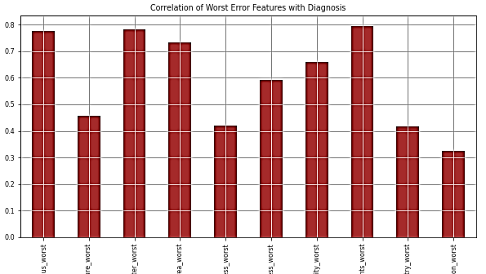
All worst features have a significant correlation with the diagnosis variable.

Slide 13
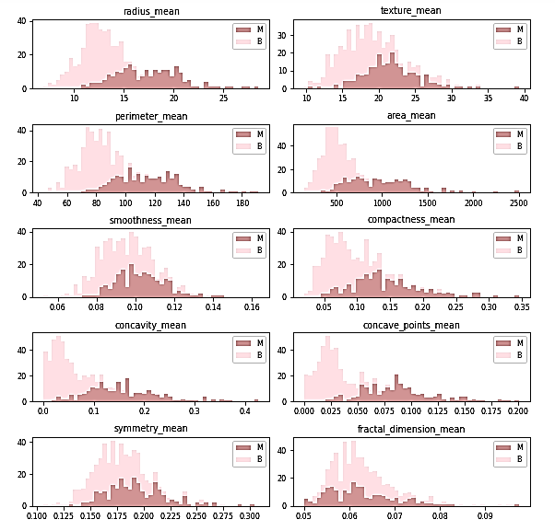
Mean features vs.
Diagnosis

Slide 14
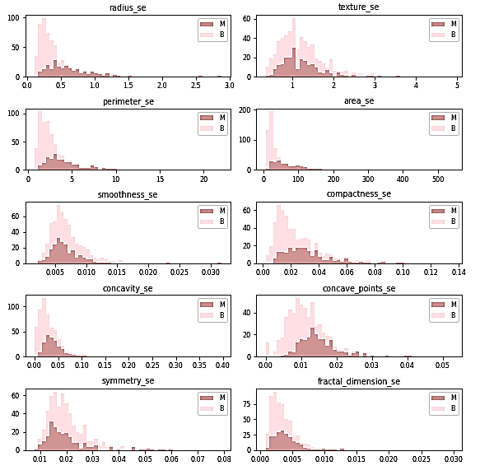
Squared error features vs.
Diagnosis

Slide 15
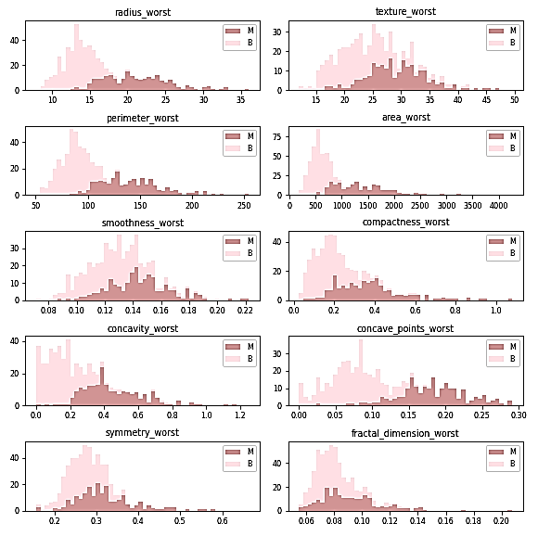
Worst features vs.
Diagnosis

Slide 16
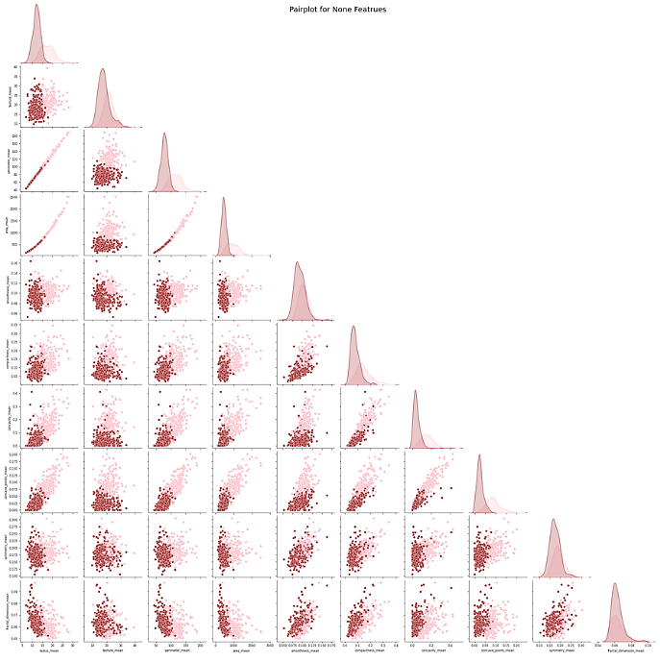
Almost perfectly linear patterns between the radius, perimeter, and area attributes and concavity, concave points, and compactness.
.
Pairplot of
mean fetures

Slide 17
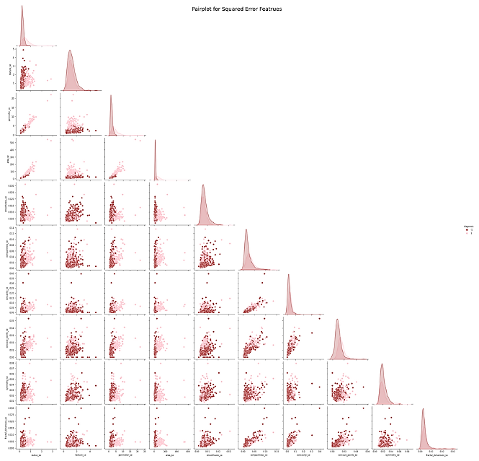
Pairplot of
squared error features
Almost perfectly linear patterns between the radius, perimeter, and area attributes.

Slide 18
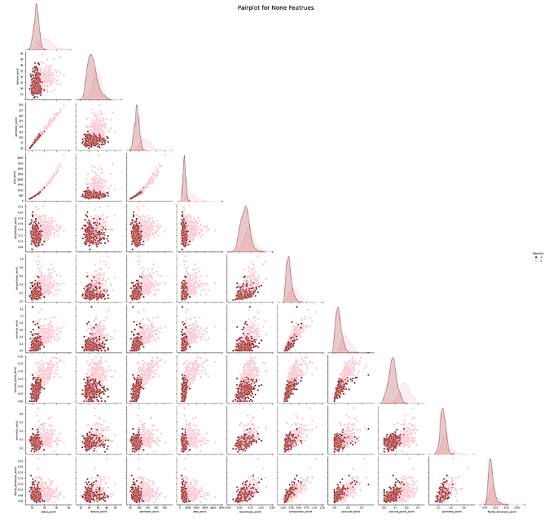
Almost perfectly linear patterns between the radius, perimeter, and area attributes and concavity, concave points, and compactness.
Pairplot of
worst features

Slide 19
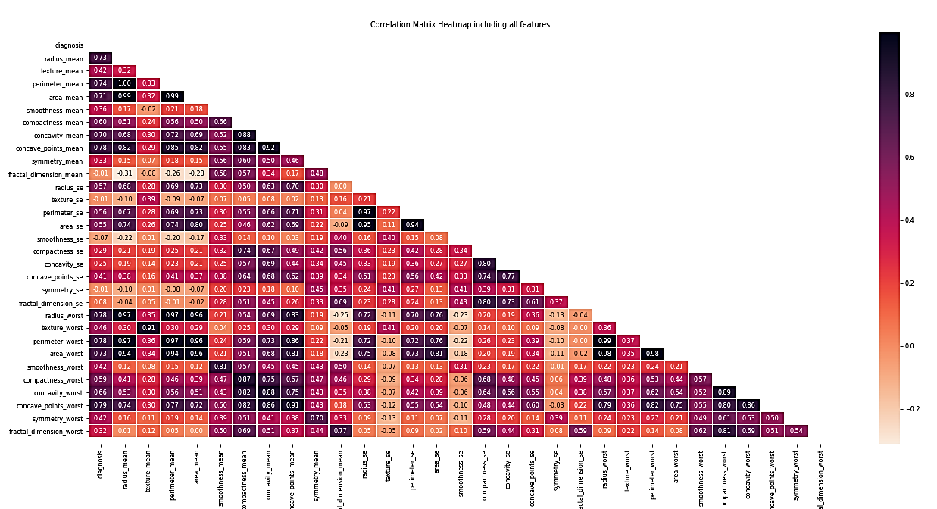
Correlation off all features
More multicollinearity
Mercury is the closest planet to the Sun and the smallest one
Venus
Venus has a beautiful name and is the second planet from the Sun

Slide 20
03 SVM

Slide 21
We split the data:
80%
20%
Training data
Testing data

Slide 22
We used
SVM
Kernel trick-’poly’
Kernel trick-’rbf’
We supposed that our classes are linearly separable
We tried to improve our results
We tried to improve our results

Slide 23
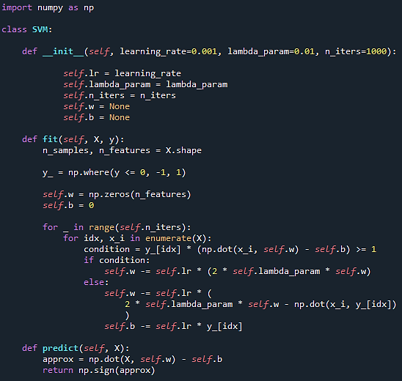
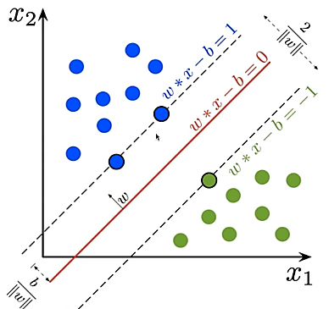
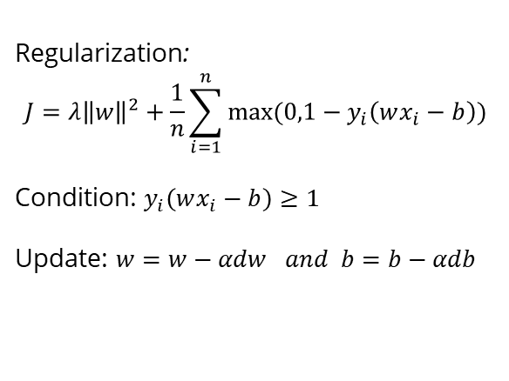
SVM
Regularization:
$$J=λ{\left\|w\right\|}^{2}+\frac{1}{n}\sum_{i=1}^{n}{max⁡(0,1−y_{i}\left(wx_{i}−b\right))}$$
Condition: $y_{i}\left(wx_{i}−b\right)≥1$
Update: $w=w−αdw and b=b−αdb$

Slide 24
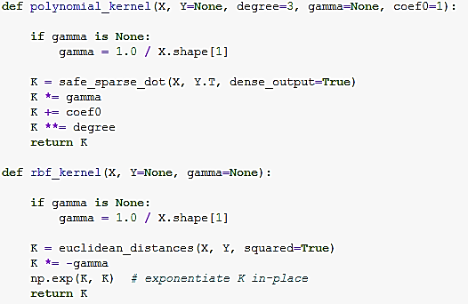

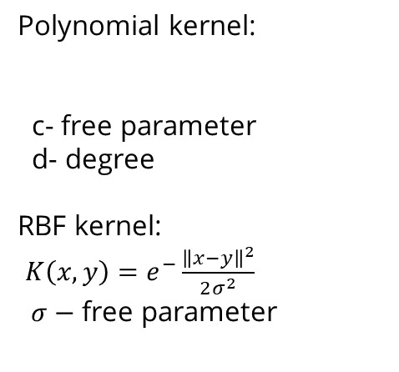
Kernels
Polynomial kernel:
c- free parameter
d- degree
RBF kernel:
$K\left(x,y\right)=e^{−}\frac{{\left\|x−y\right\|}^{2}}{2σ^{2}}$
$σ−$ free parameter
$$K\left(x,y\right)={(x^{T}y+c)}^{d}$$

Slide 25
04 Results

Slide 26
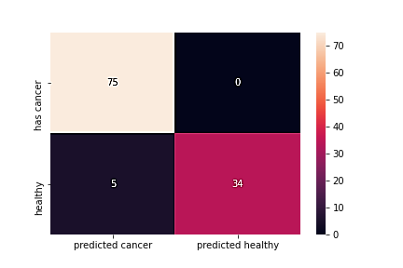

SVM results:

Slide 27


SVM results for scaled data:
Best

Slide 28
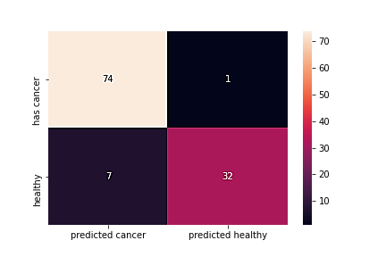

Polynomial kernel-results:

Slide 29
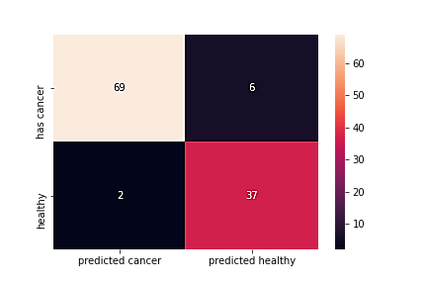

RBF kernel results:

Slide 30
To conclude...
We had a data set with 32 columns, which described the parameters of a tumor cell and a healthy cell
The task was to classify on new data whether the tumor was malignant or benign
We assumed that the classes are linearly separable
We applied the SVM that gave us the best results on scaled data , therefore we claim that the classes are linearly separable
In future work we would try to solve multicollinarity problem by picking one of every three columns for analysis

Slide 31




Our Team
Dragana Šorak
Sonja Jamina

Slide 32

Thank you for attention!

